Slide 1

-Deeksha
Zipf’s Law
Data Source Experiment

Slide 2
Zipf’s Law
Overview
An empirical law formulated using mathematical statistics, refers to the fact that many types of data studied in the physical and social sciences can be approximated with a Zipfian distribution, one of a family of related discrete power law probability distributions. The law is named after the American linguist George Kingsley Zipf (1902–1950), who popularized it and sought to explain it (Zipf 1935, 1949), though he did not claim to have originated it. ¹
¹ Powers, David M W (1998). "Applications and explanations of Zipf's law". Association for Computational Linguistics: 151–160. External link in |title= (help)
1
Rank

Slide 3

Zipf’s Law
Experiment
Books
20.3%
Populations
33.9%
Events
101.2%

Slide 4
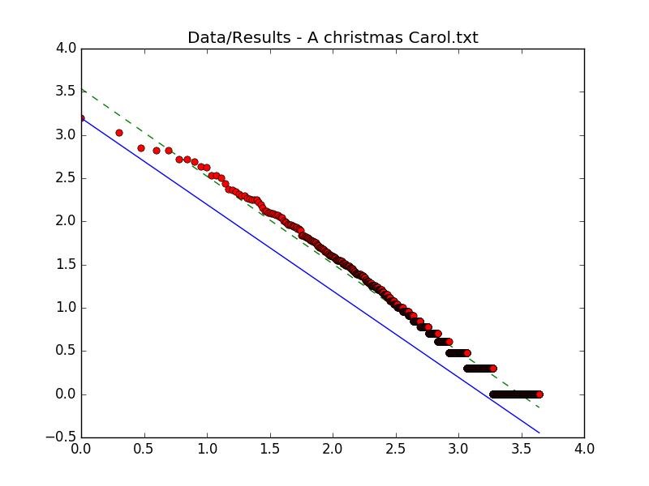
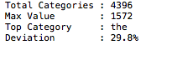
Zipf’s Law
Book’s Experiment
A Christmas Carol
Trend Line
Zipf’s Law

Slide 5
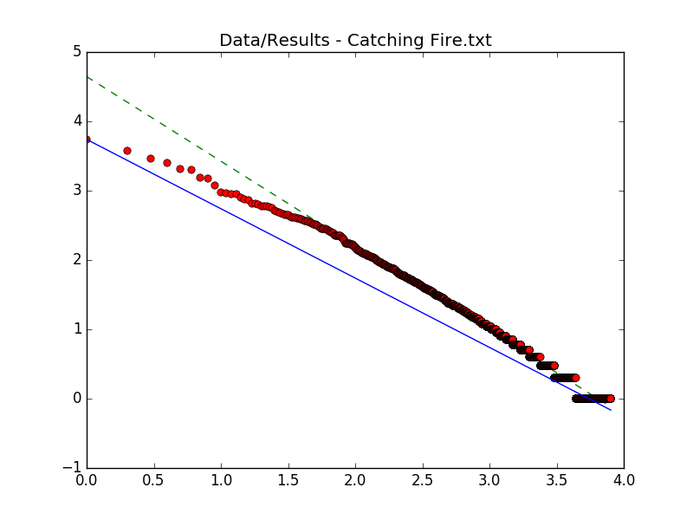
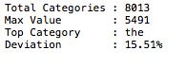
Zipf’s Law
Book’s Experiment
Catching Fire
Trend Line
Zipf’s Law

Slide 6
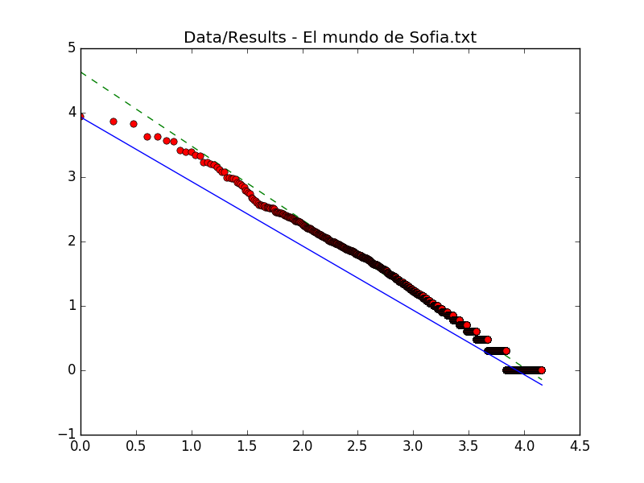
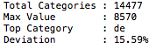
Zipf’s Law
Book’s Experiment
El Mundo de Sofía
Trend Line
Zipf’s Law

Slide 7
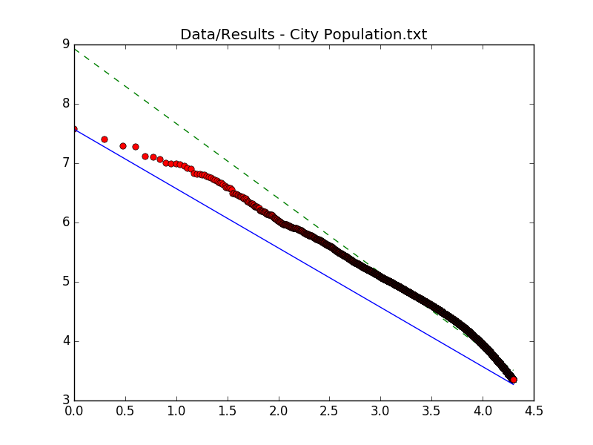
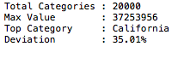
Zipf’s Law
Population’s Experiment
US Population
Trend Line
Zipf’s Law

Slide 8
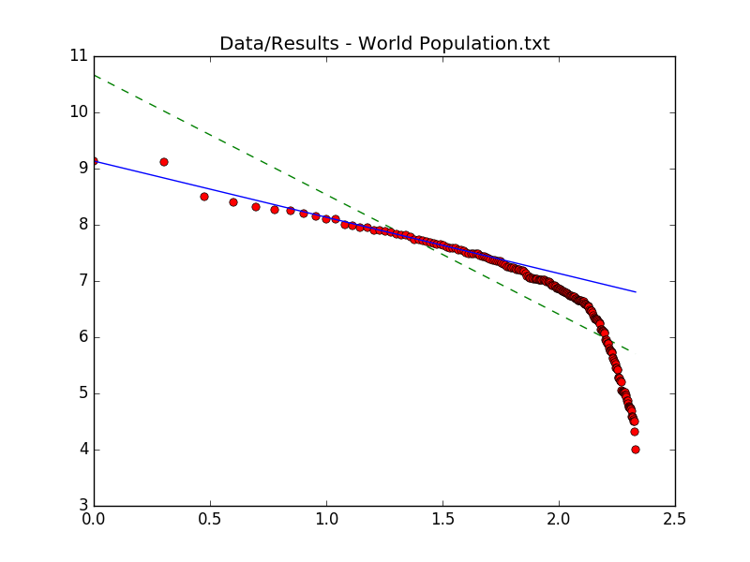
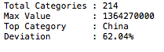
Zipf’s Law
Population’s Experiment
World’s Population
Trend Line
Zipf’s Law

Slide 9
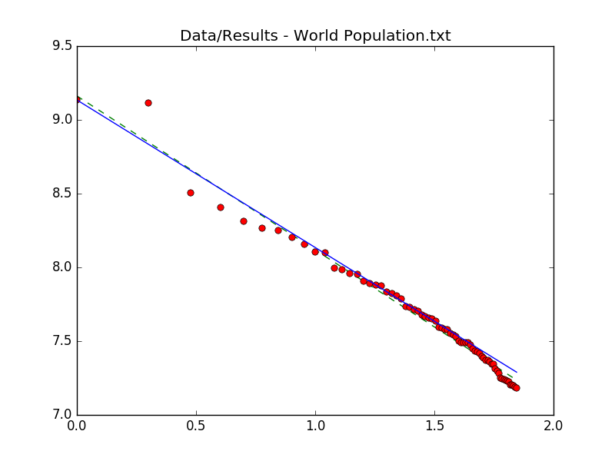
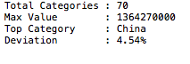
Zipf’s Law
Population’s Experiment
Top 70 World’s Population
Trend Line
Zipf’s Law

Slide 10
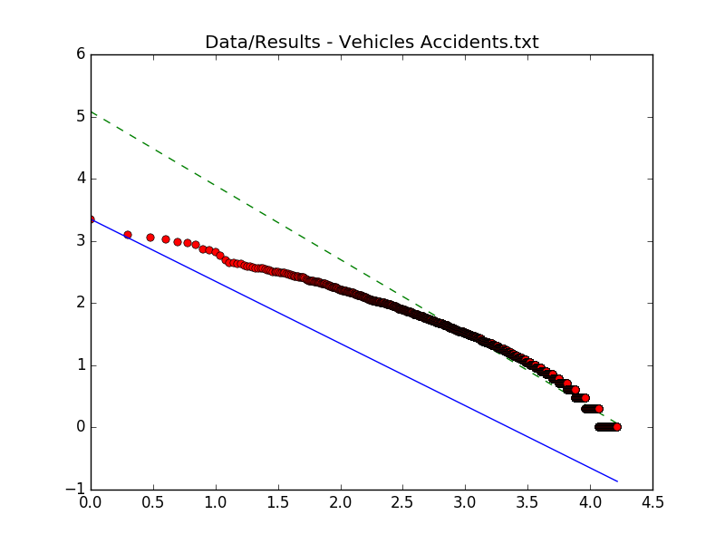
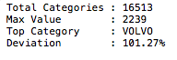
Zipf’s Law
Event’s Experiment
Vehicles Accidents
Trend Line
Zipf’s Law

Slide 11
Zipf’s Law
Conclusion
An empirical law formulated using mathematical statistics, refers to the fact that many types of data studied in the physical and social sciences can be approximated with a Zipfian distribution, one of a family of related discrete power law probability distributions. The law is named after the American linguist George Kingsley Zipf (1902–1950), who popularized it and sought to explain it (Zipf 1935.

Slide 12
Zipf’s Law
Questions?

